Slide 1

CNN based Invisible QR code embedded Id cards
Dhruva Mhatre 18104045
Chirag Jain 18104002
Prem Vispute 18104059
Project Guide
Prof. Kiran Deshpande
Project Co-Guide
Prof. Kaushiki Upadhyay

Slide 2
Contents
Introduction
Literature Review
Objectives
Scope
Technology Stack
Block Diagram to propose project idea.
Demonstration (Desired)
References

Slide 3
1. Introduction
Problem Identified :
  ID card contains personal information of the person (e.g. Mobile no. , address etc), this information can be misused if fallen into wrong hands.
Solution Proposed :
  In the proposed system, we generate a QR code consisting of the user info and embed it (Invisible QR code) in the user Photo on the ID card.

Slide 4
2. Literature Review
Sr. No. | Authors | Paper Tittle | Methodologies | Findings
1. | Kaihua Song Ning Liu Zhongpai Gao Jiahe Zhang Xiao-Ping Zhang | DEEP RESTORATION OF INVISIBLE QR CODE FROM TPVM DISPLAY | Temporal psychovisual modulation (TPVM). deep convolutional neural networks (DCNN) | Embedding QR using TPVM and restoring it using DCNN
2. | Hiroyuki Kobayashi, Kohei Yamauchi | A CNN BASED INVISIBLE QR CODE GENERATOR FOR HUMAN LIVING SPACE | Using convolutional neural networks (CNN) for embedding and restoring image | This models compose of 2 CNNs and was able to embed and restore arbitrary information in the image.

Slide 5
3. Objectives
To provide data security by data hiding.
To maintain integrity and readability of the ID card by hiding the QR and providing necessary information.
To reduce data exposure and security threat.
To develop a QR code generator using pyqrcode module in python.
Embed the QR code generated in the required image using CNN.
To develop a QR scanner to decode the QR code.
Create a web based application which will generate report based on the data fetched from scanner.

Slide 6
4. Scope
Can be applied in the educational institutions for maintaining and monitoring the attendance of the students.

Slide 7
5. Technology Stack
Python (pyqrcode, numpy, matplotlib)
CNN ( Tenserflow, keras)
MongoDB
Express
React
Node

Slide 8
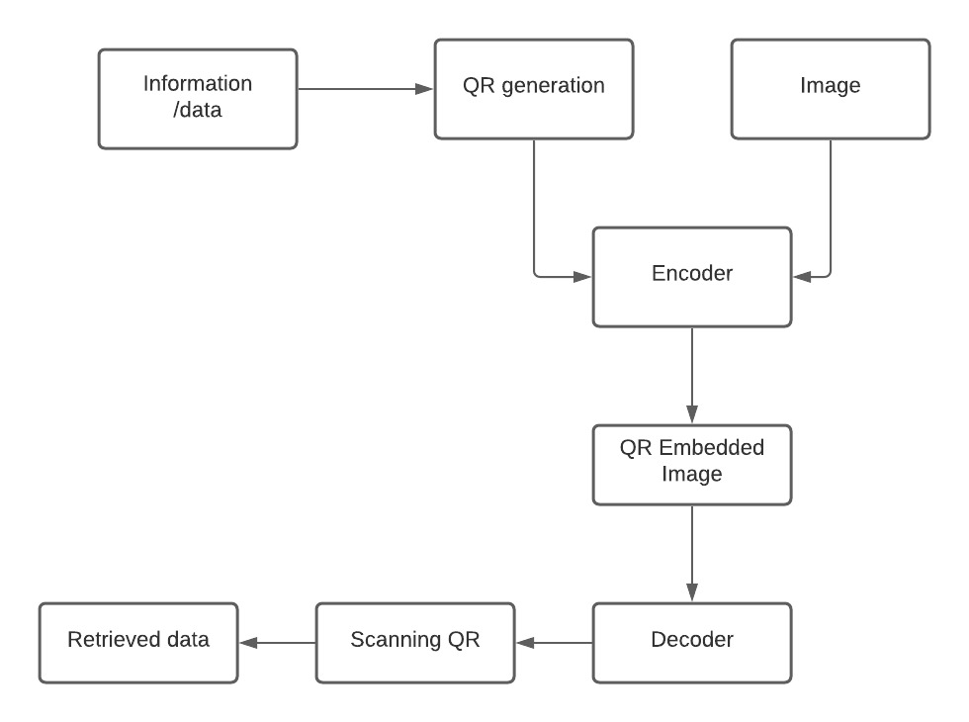
6. Block Diagram to propose project Idea

Slide 9
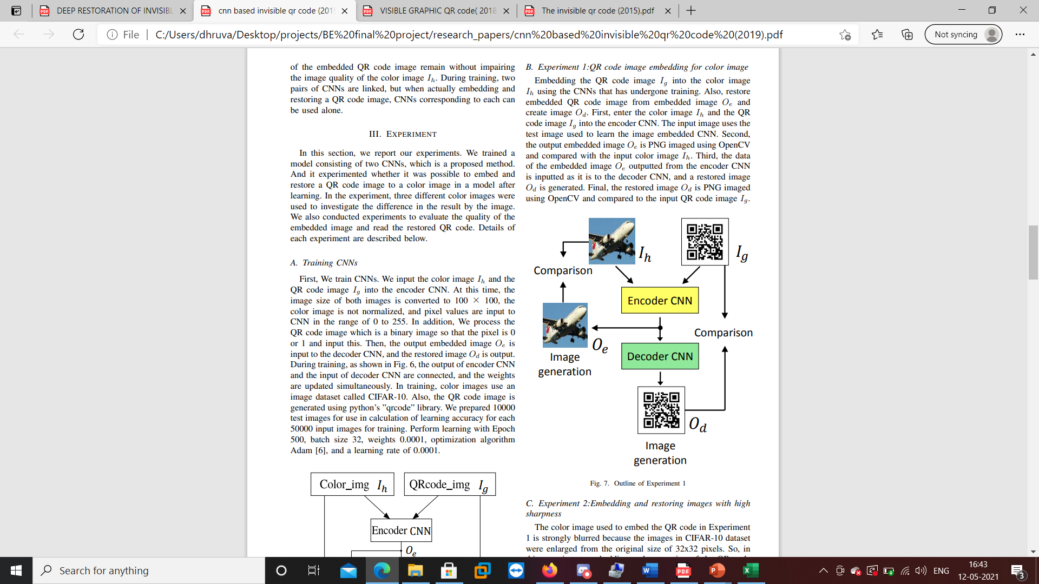
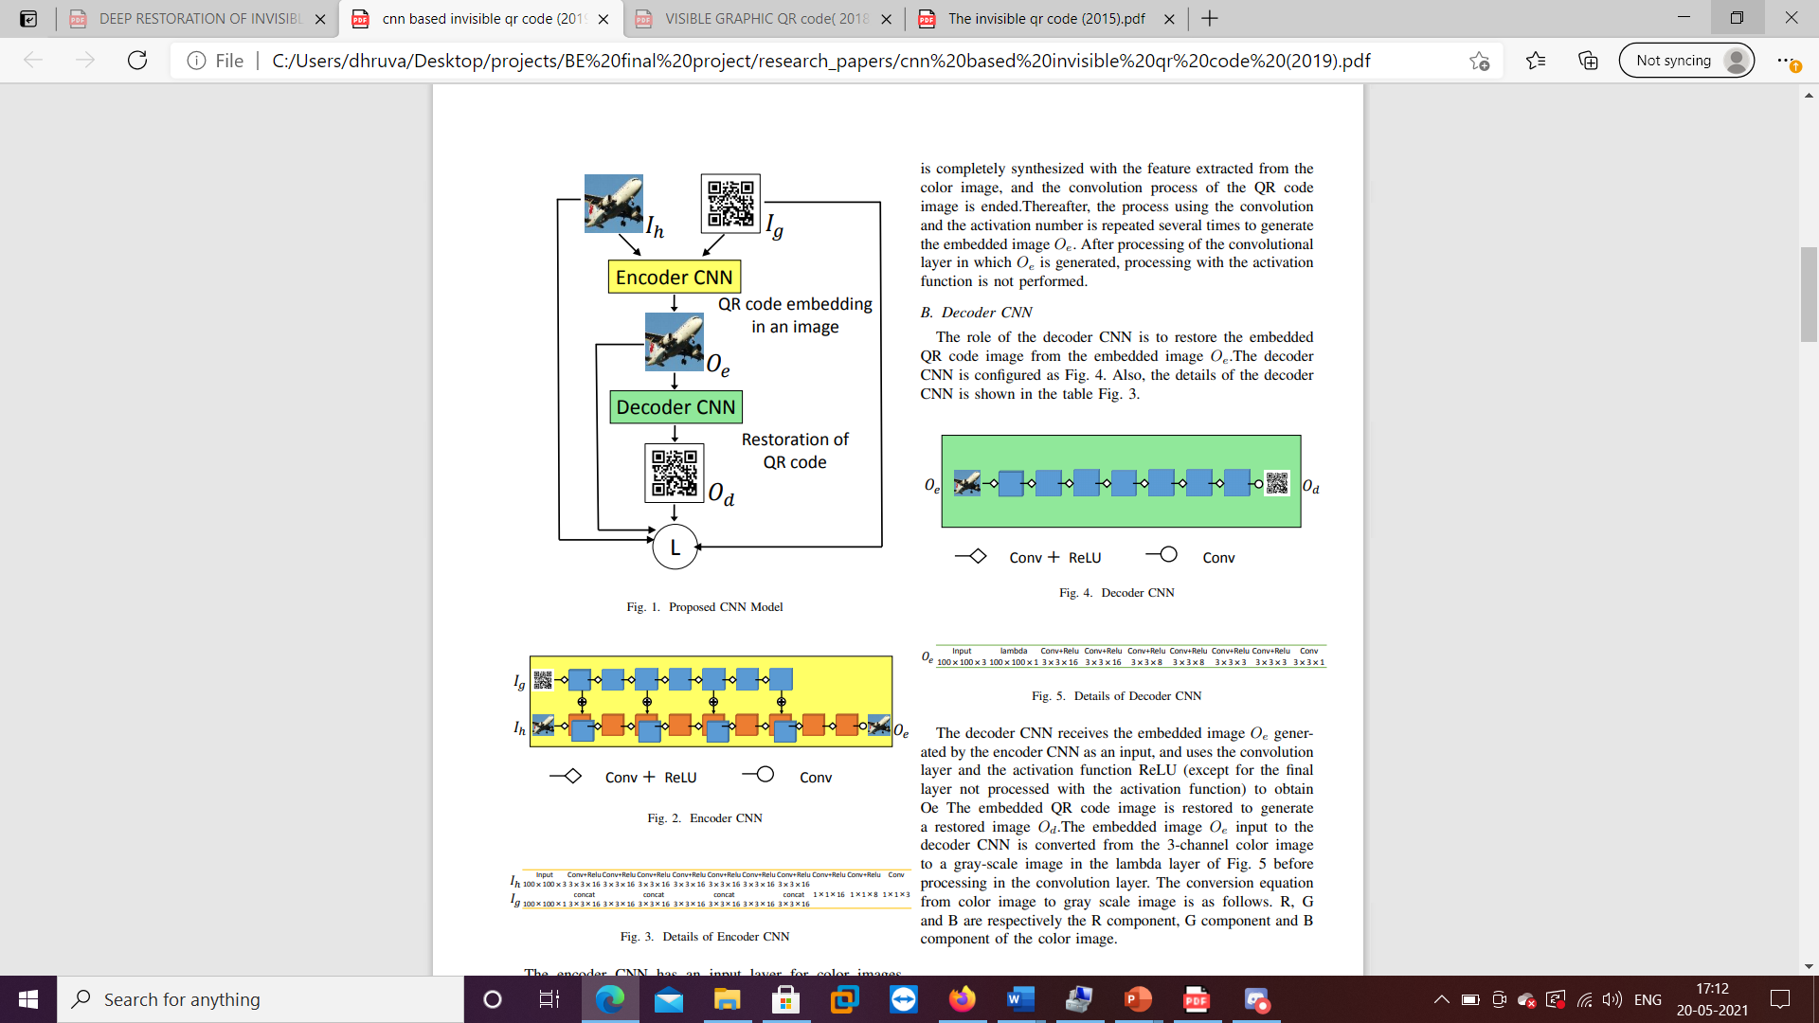
7. Demonstration
(Desired)
Encoder CNN :
Decoder CNN :
Source: K. Yamauchi and H. Kobayashi, "A CNN based invisible QR code generator for
human living space," IECON 2019 - 45th Annual Conference of the IEEE Industrial
Electronics Society, Lisbon, Portugal, 2019

Slide 10
8. References
K. Yamauchi and H. Kobayashi, "A CNN based invisible QR code generator for human living space," IECON 2019 - 45th Annual Conference of the IEEE Industrial Electronics Society, Lisbon, Portugal, 2019
K. Song, N. Liu, Z. Gao, J. Zhang, G. Zhai and X. -P. Zhang, "Deep Restoration of Invisible QR Code from TPVM Display," 2020 IEEE International Conference on Multimedia & Expo Workshops (ICMEW), London, UK, 2020
Zhongpai Gao, Guangtao Zhai and Chunjia Hu, “The Invisible QR Code”, MM '15 Proceedings of the 23rd ACM international conference on Multimedia, October 2015

Slide 11
Thank You...!!

